Slide 1
Finding evolutionary shifts

Slide 2
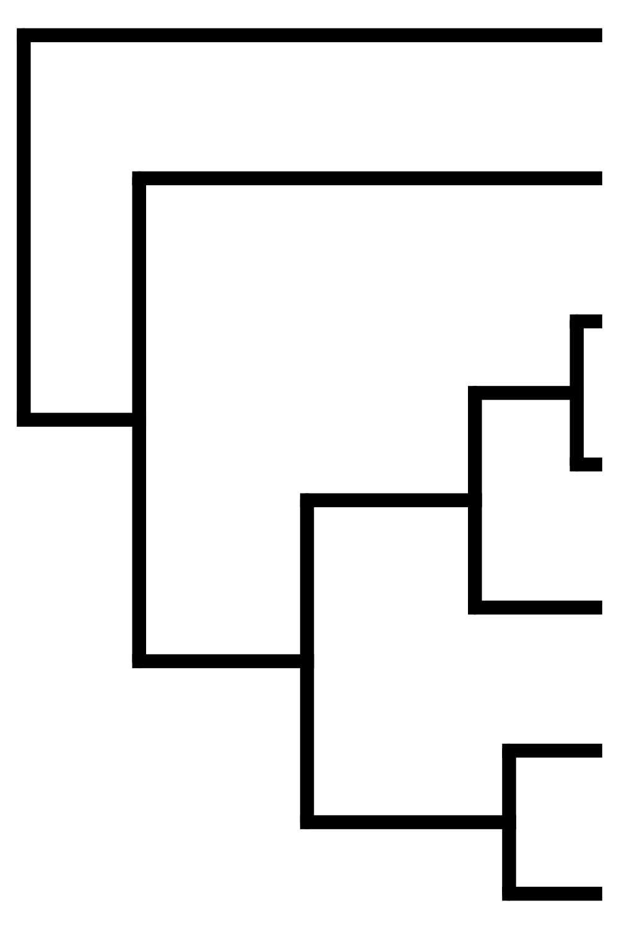
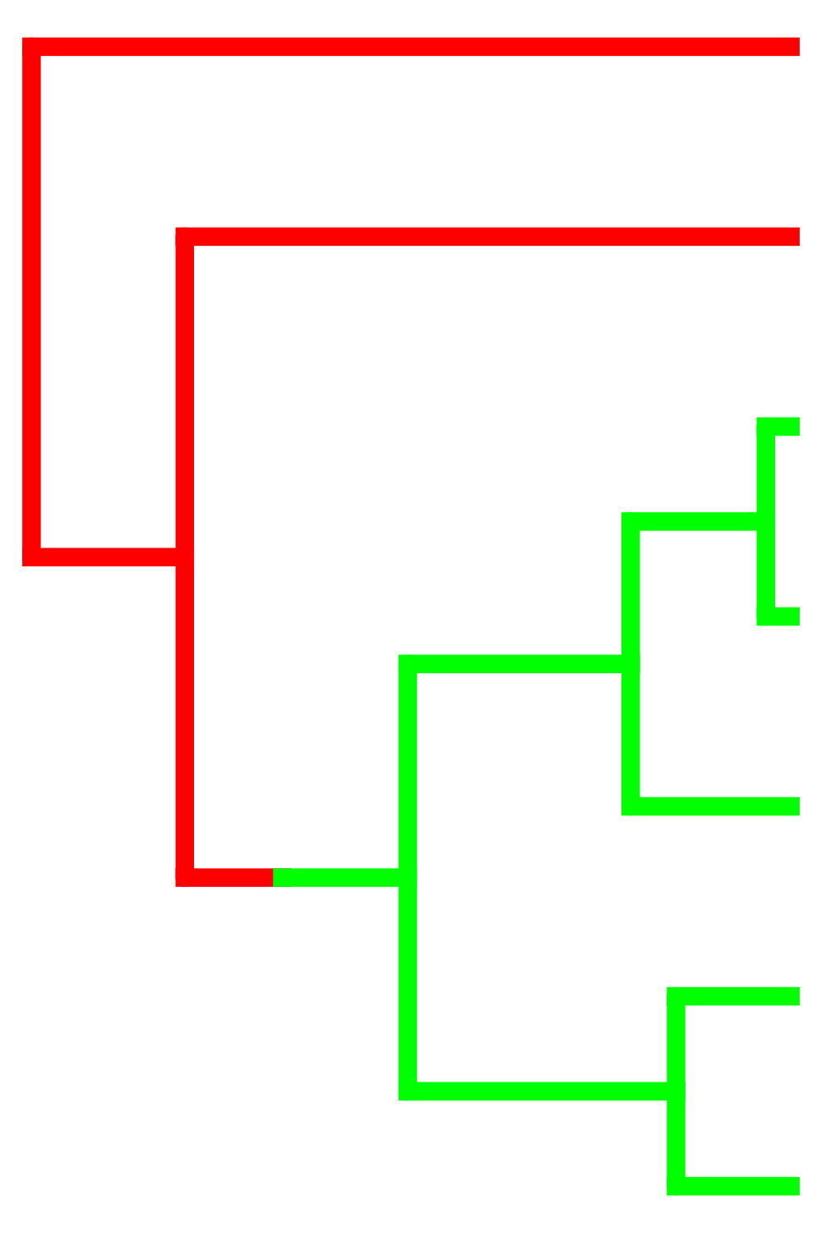
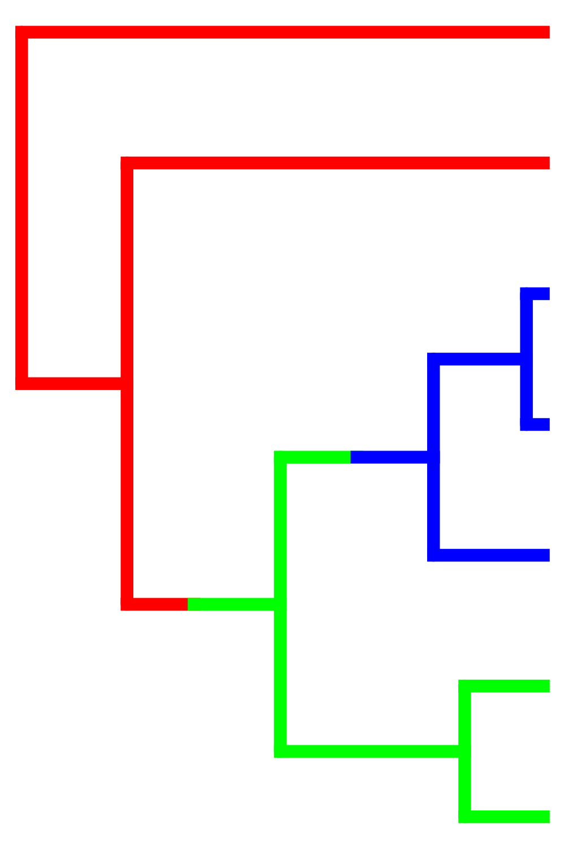







Slide 3
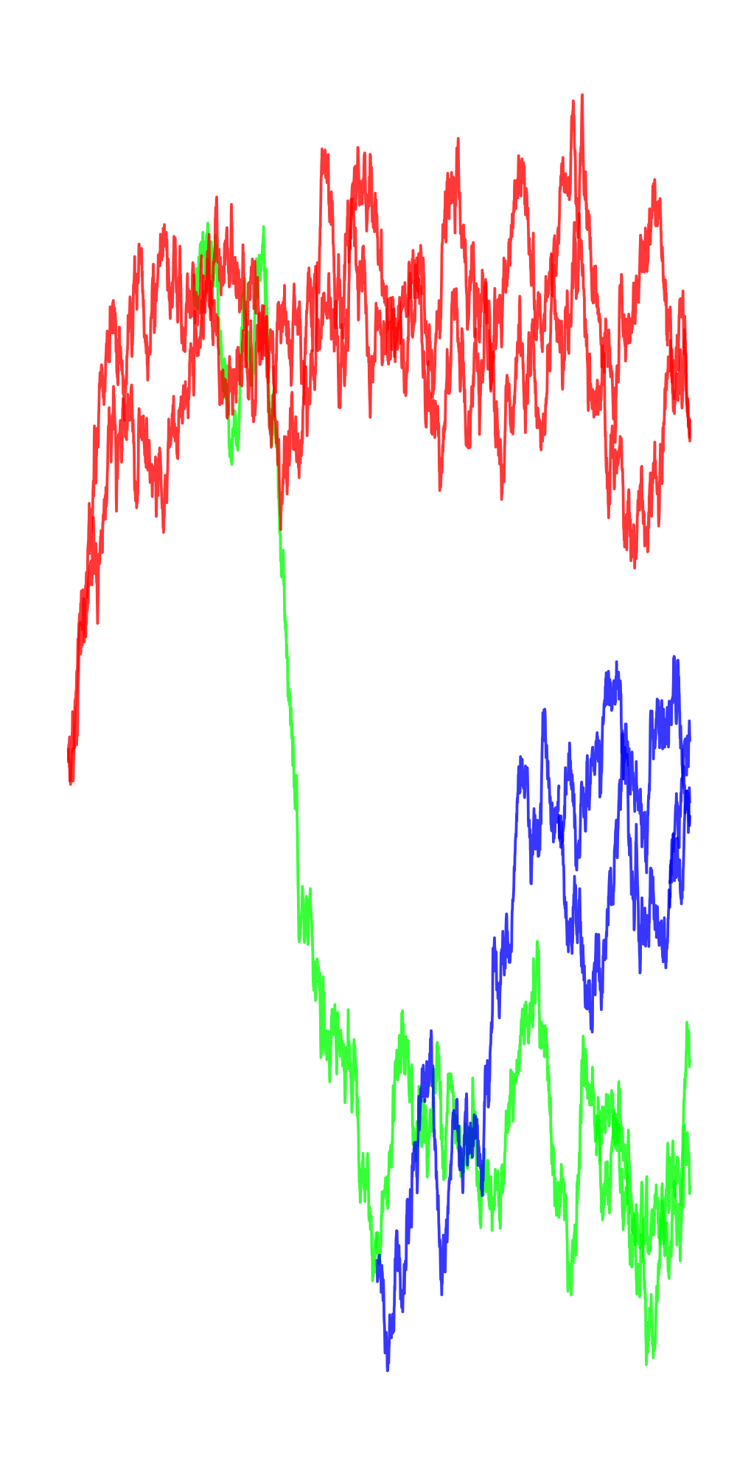
θ₁
θ₂
θ₃
Ornstein-Uhlenbeck
(Hansen 1997, Butler & King 2004)

Slide 4
Compare models
(e.g. by AIC)
Best Model
(Hansen 1997, Butler & King 2004)

Slide 6
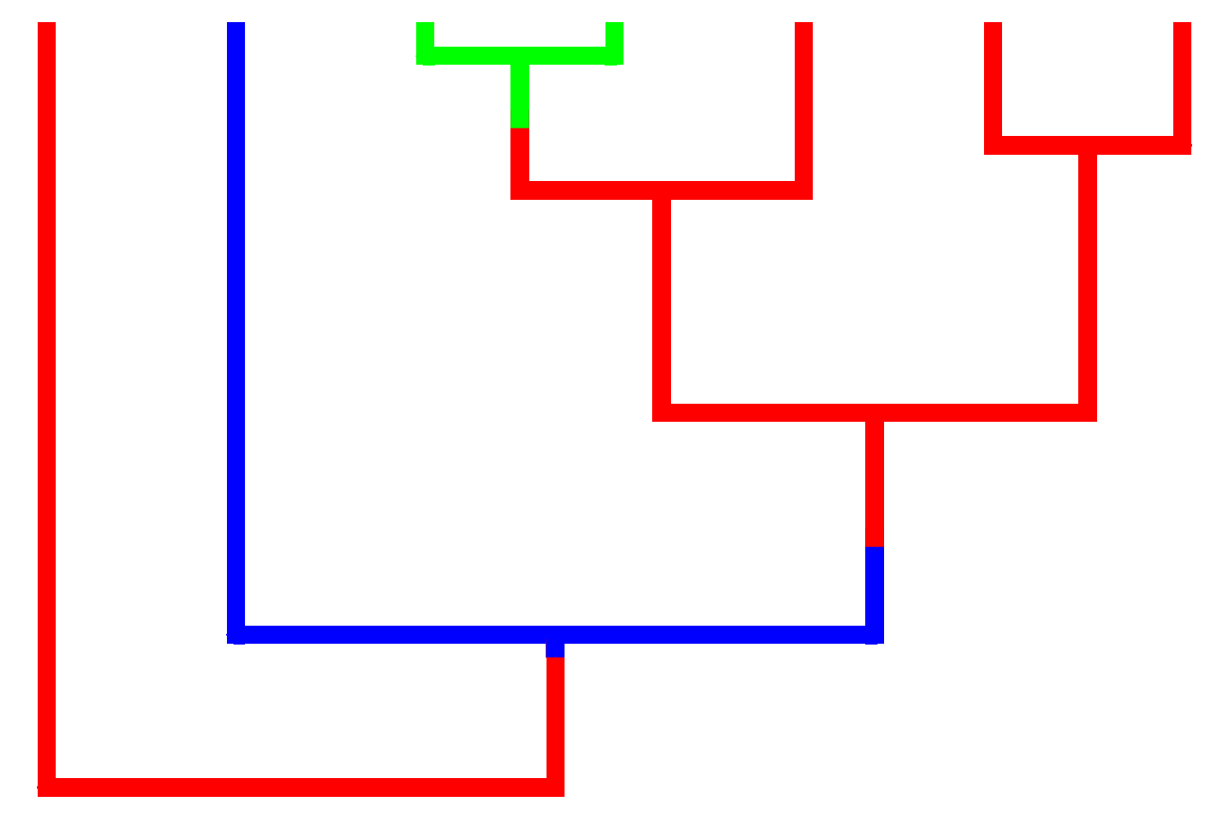

Uyeda & Harmon 2014

Slide 7
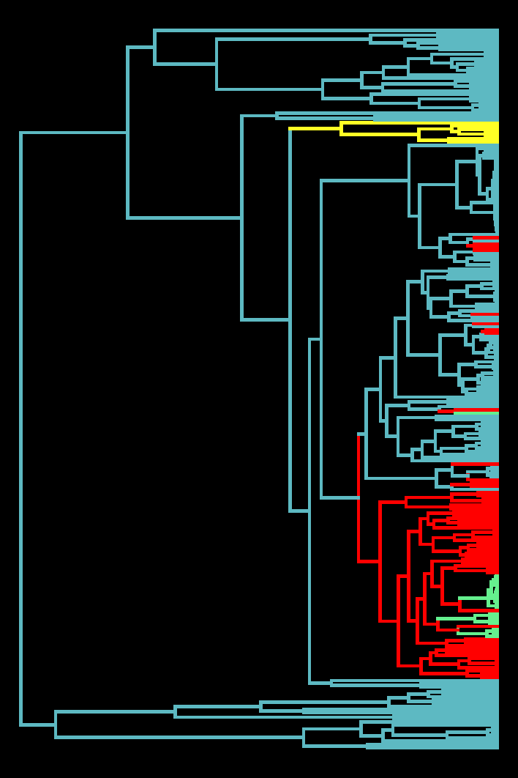




Turtles and Tortoises
(Jaffe et al. 2011)
Marine
Freshwater
Terrestrial
Island

Slide 8
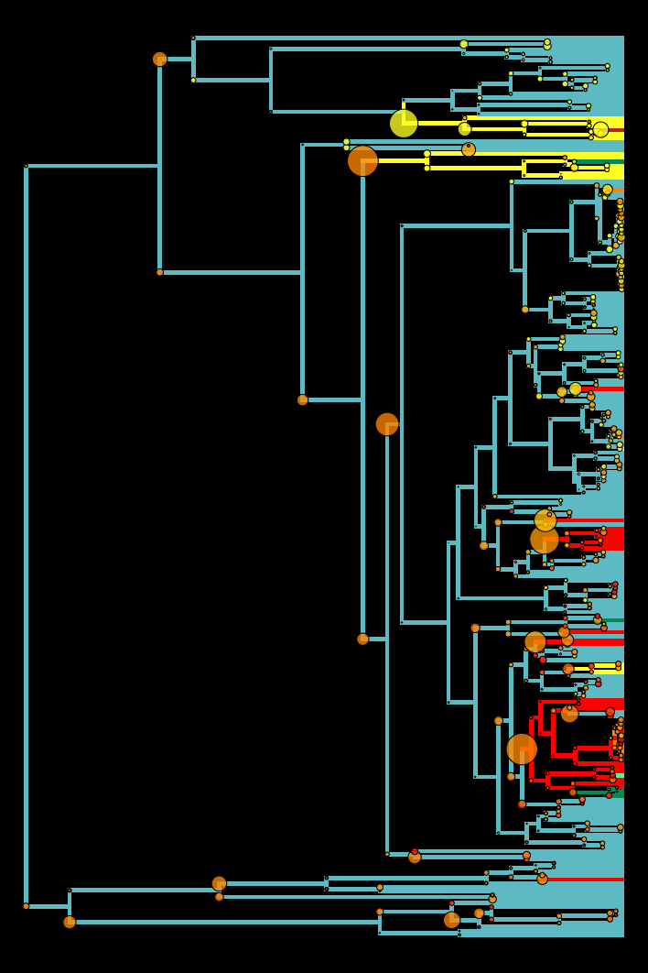
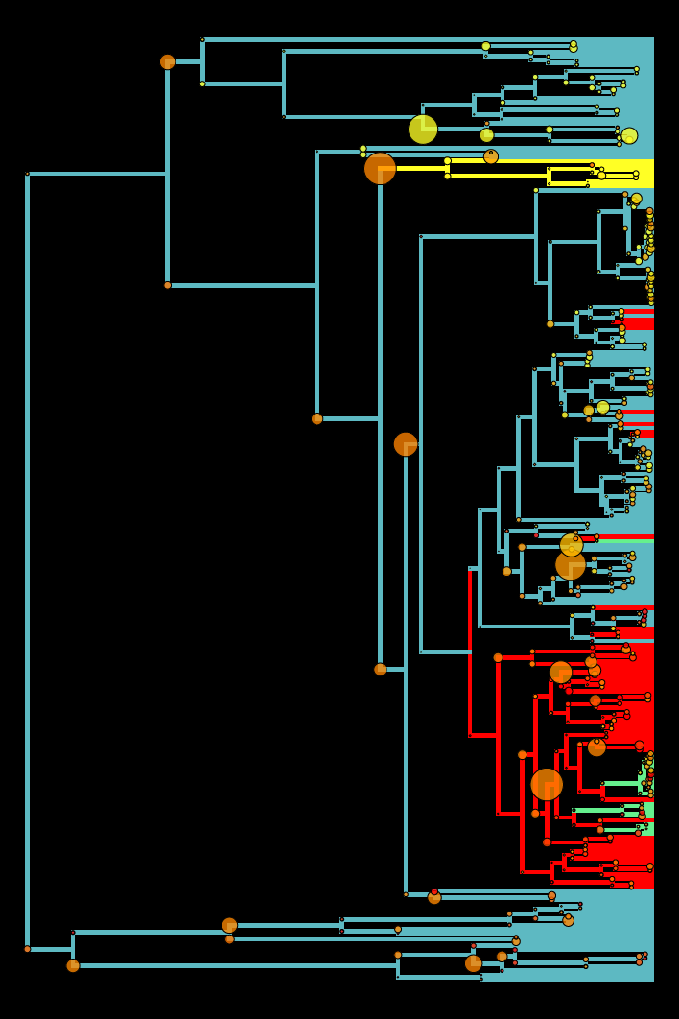



(Uyeda and Harmon, 2014)
surface Model
Habitat Model
bayou Model
bayou Model
bayou $θ$: 8 – 167 cm
surface $θ$: 2.9x10⁻¹⁷⁰fm– 1.96x10⁴⁴ km
surface
(Ingram & Mahler, 2012)

Slide 9


Slide 10
bayou (Uyeda and Harmon, 2014)
surface Model
Habitat Model
bayou Model
bayou Model
bayou $θ$: 8 – 167 cm
surface $θ$: 2.9x10⁻¹⁷⁰fm– 1.96x10⁴⁴ km
bayou phy. half-life = 3.94 million years
surface phy. half-life = 92 million years

Slide 11
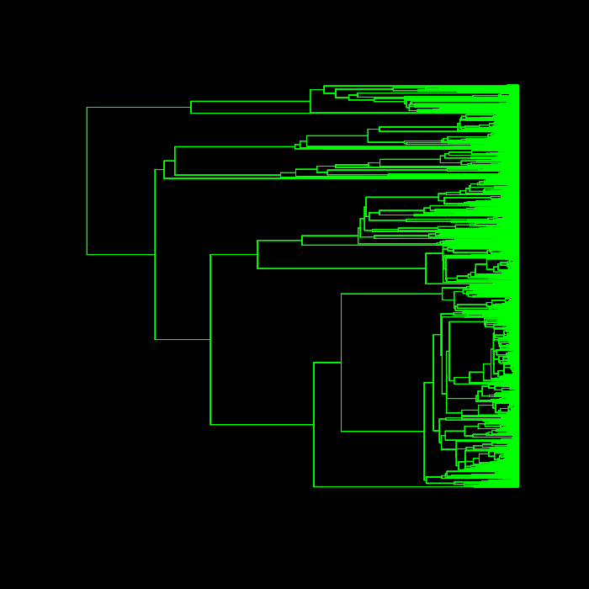
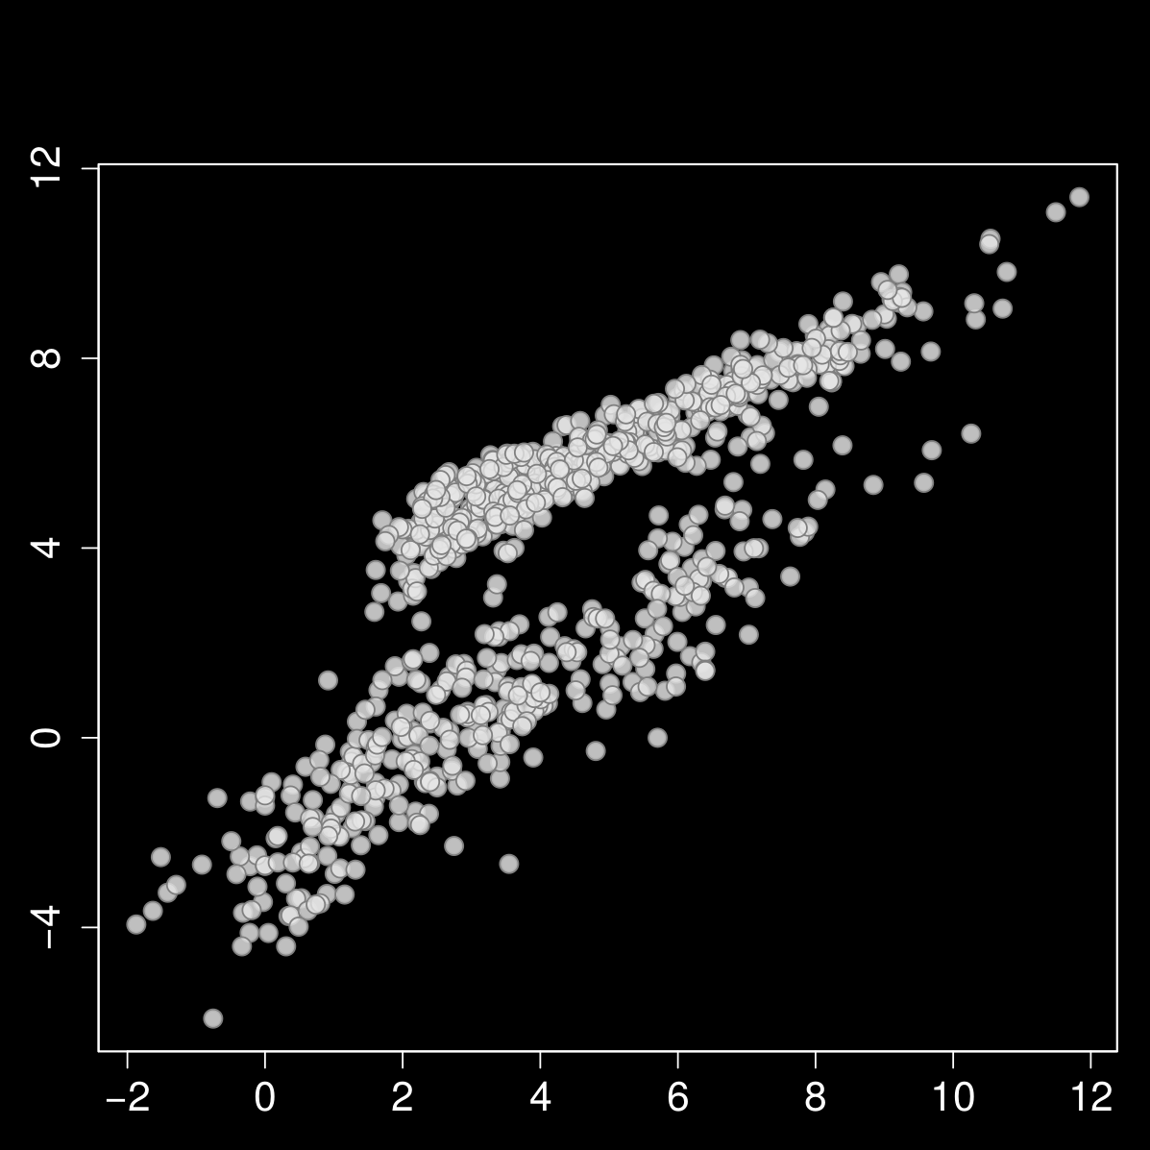
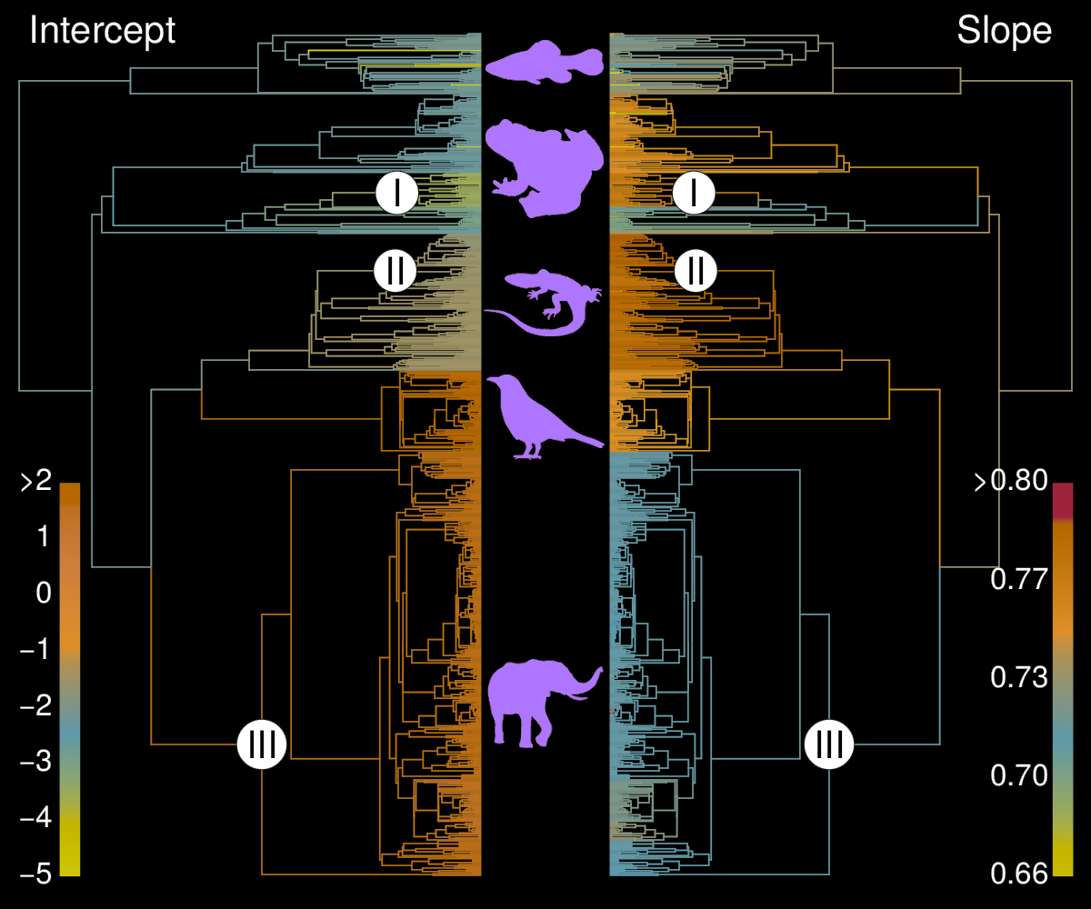
Metabolic Rate Allometry
857 species
ln SMR
White et al., 2006
ln Mass

Slide 12
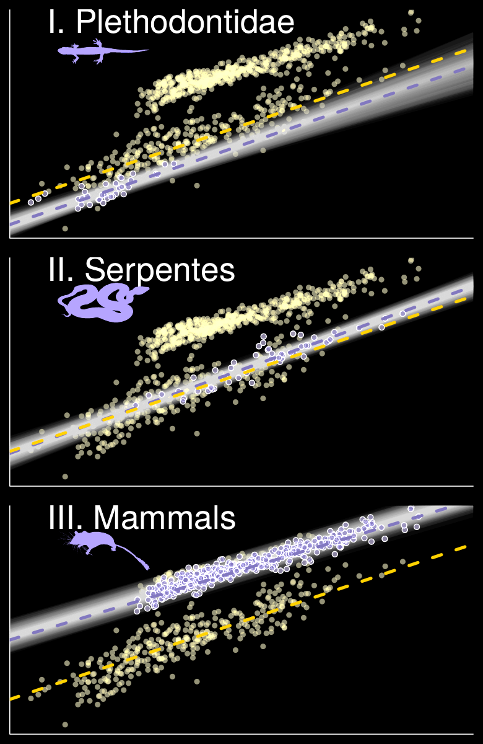

Slide 13
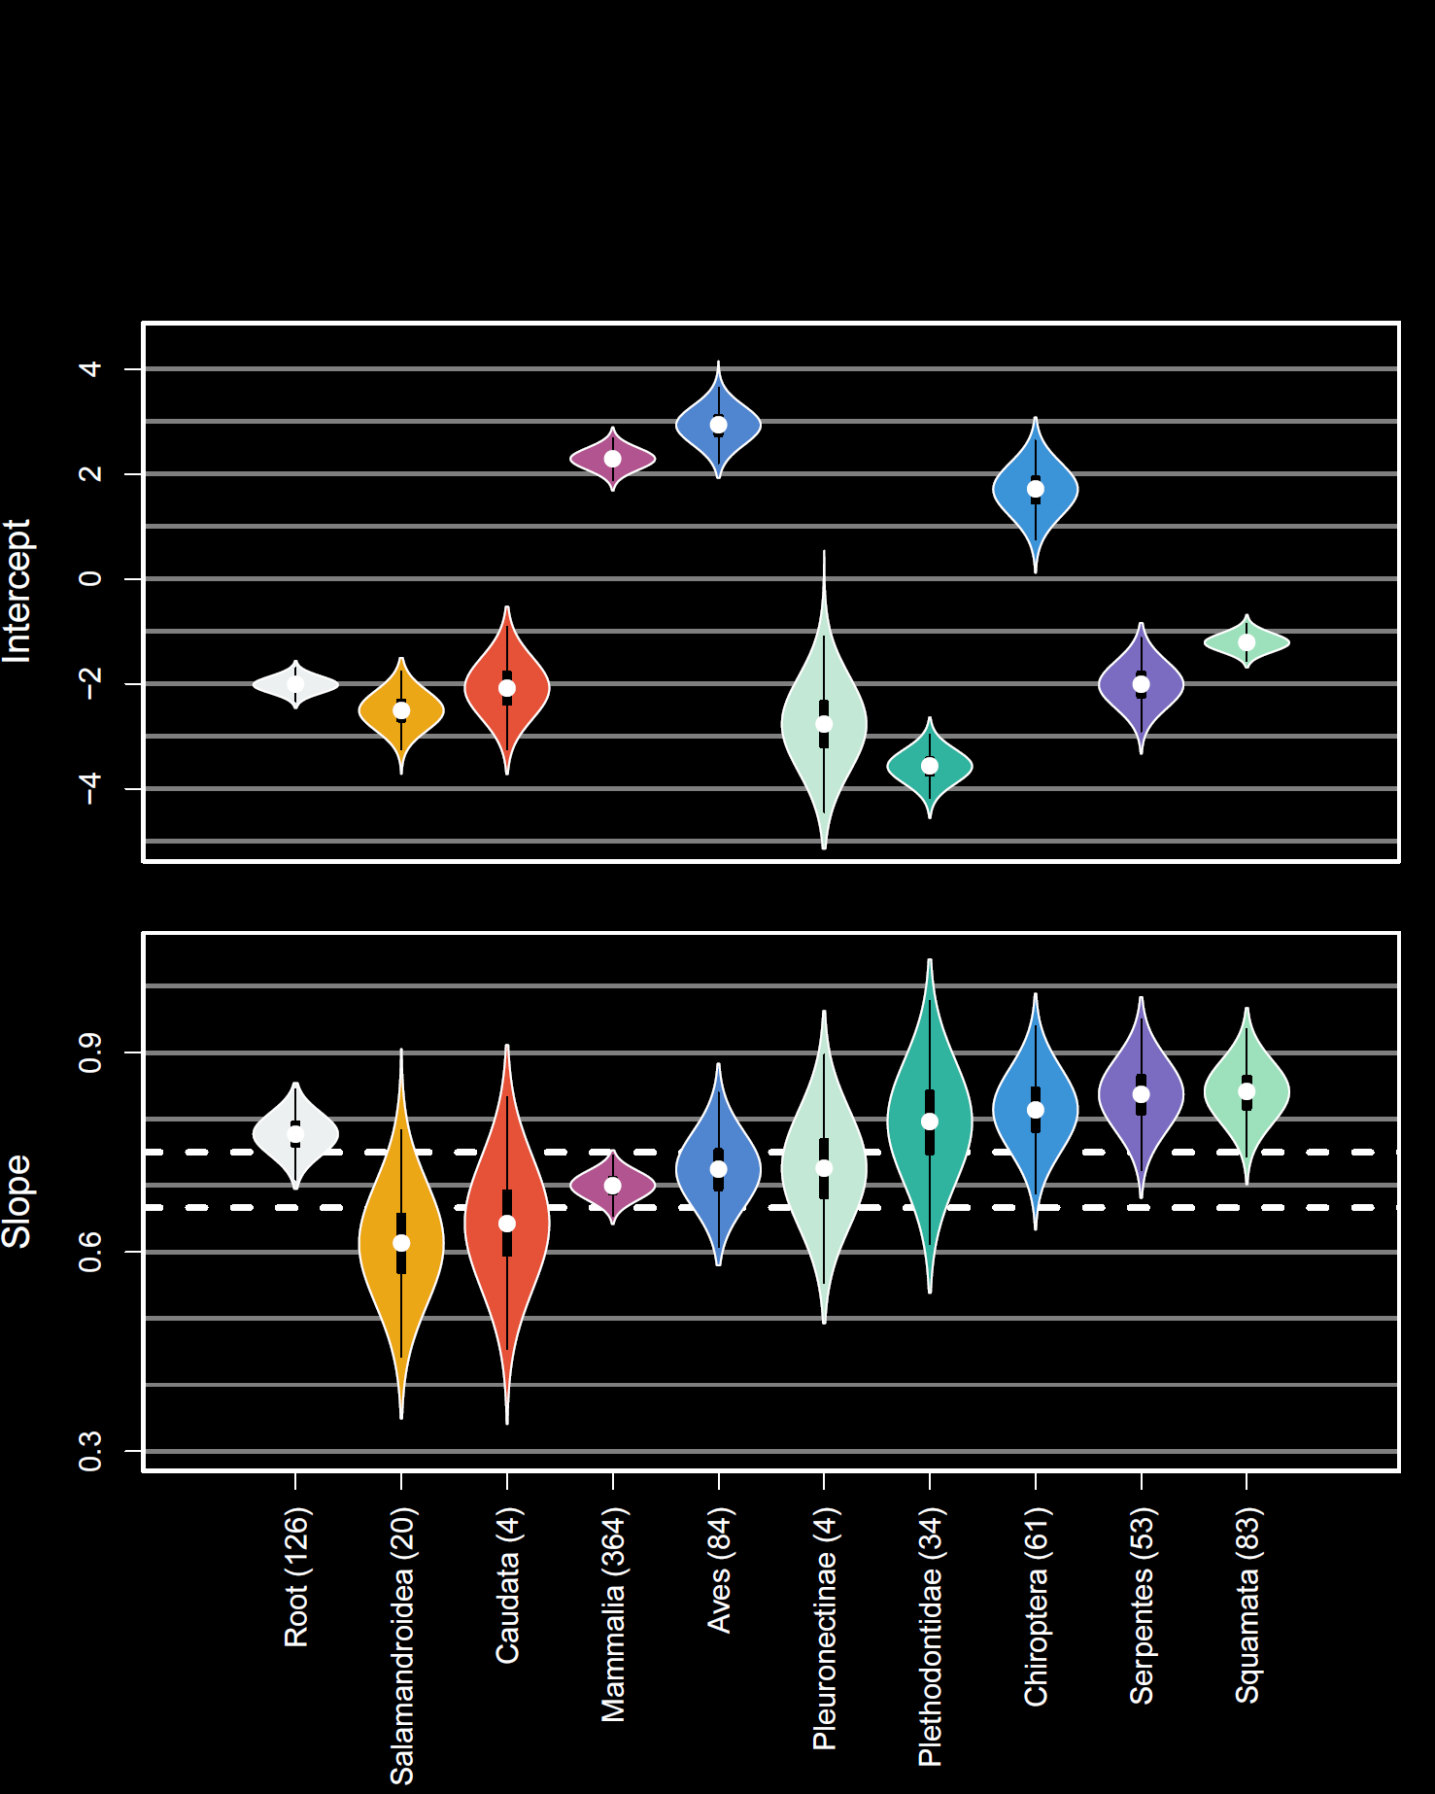
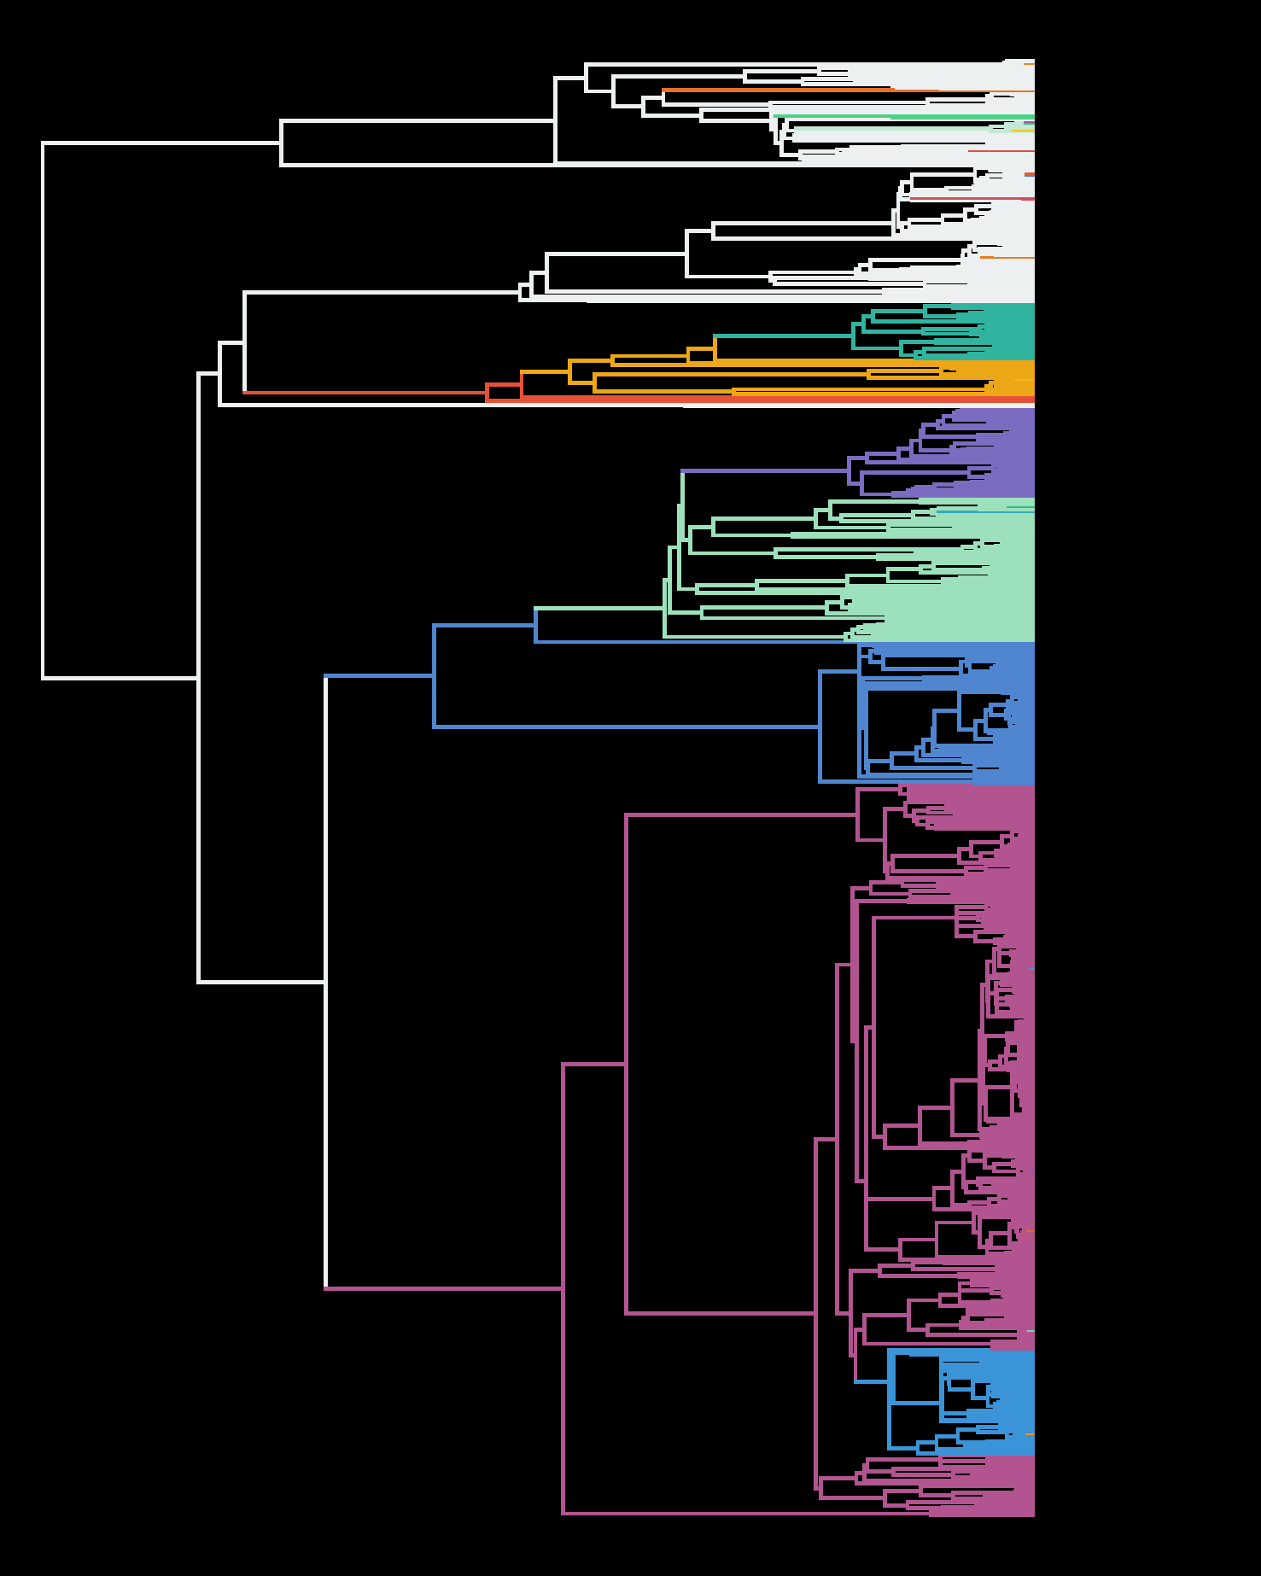









Slide 14
Shifts in Fossil Data: Unique Opportunities

Slide 15
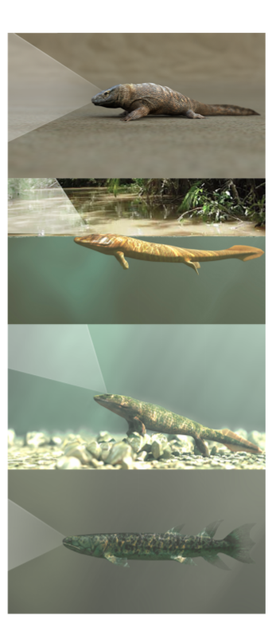
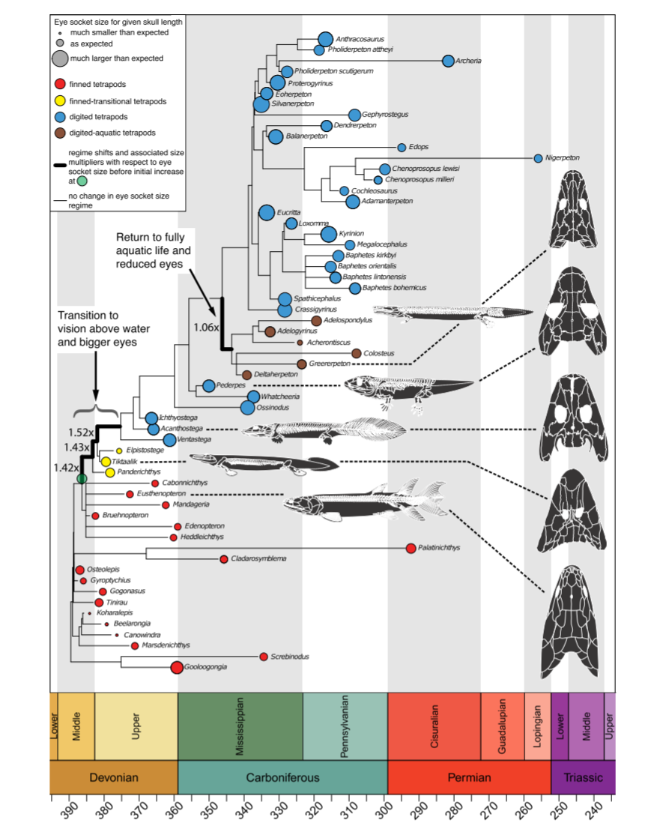
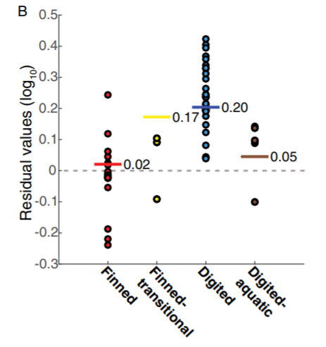
McIver et al. 2017, PNAS
halflife =
5.79 my

Slide 16
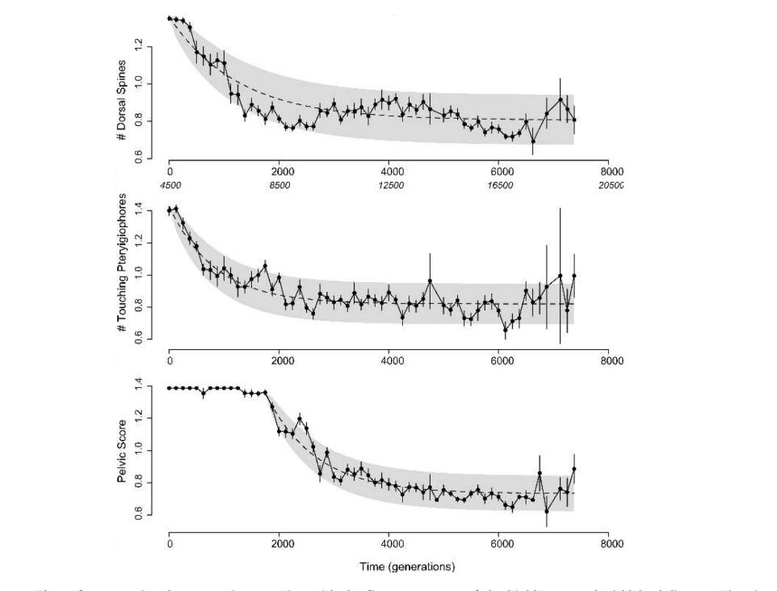
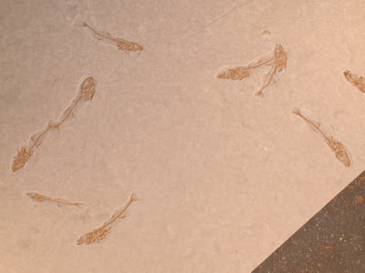
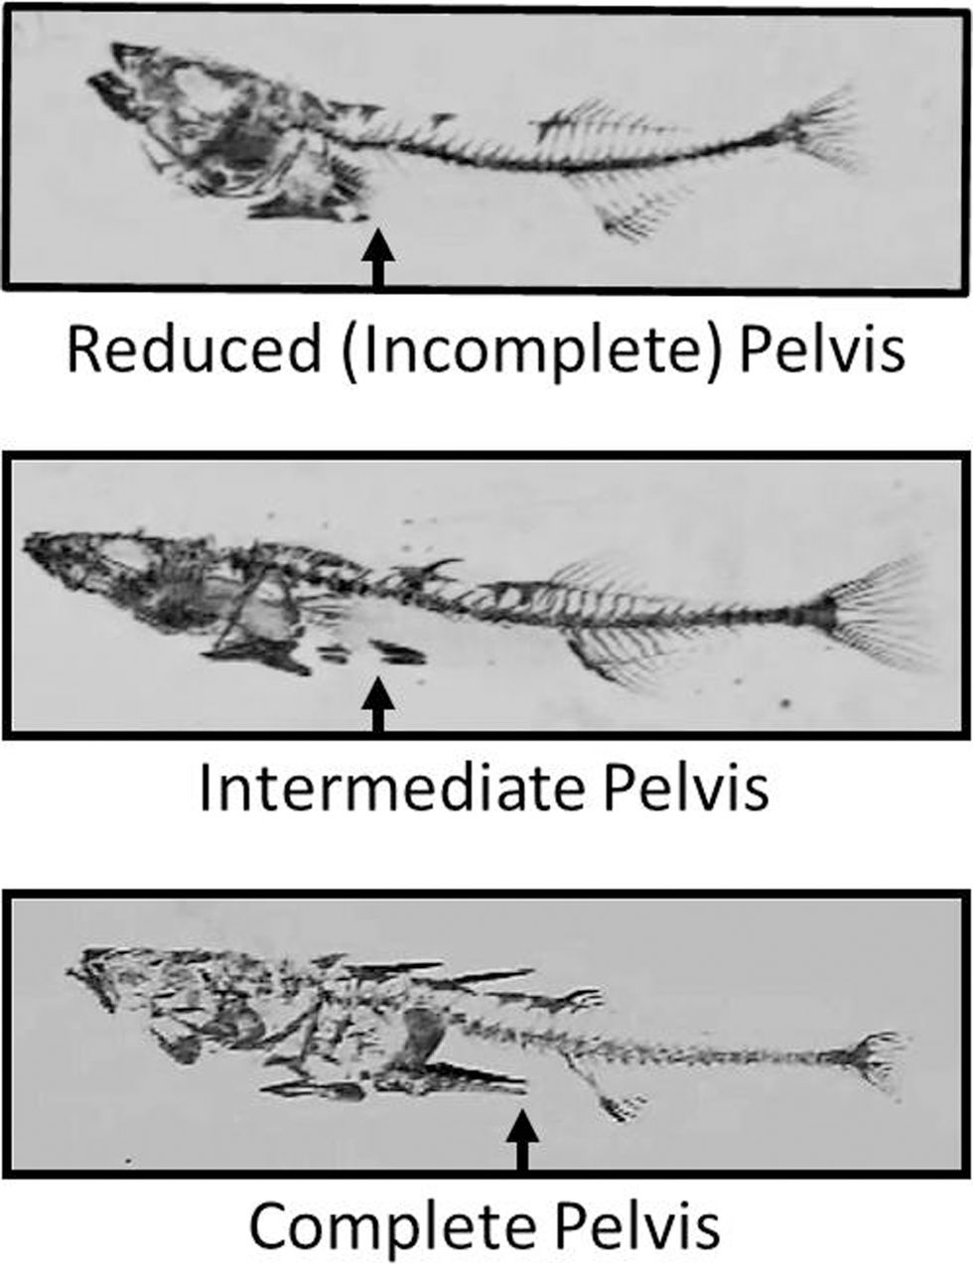
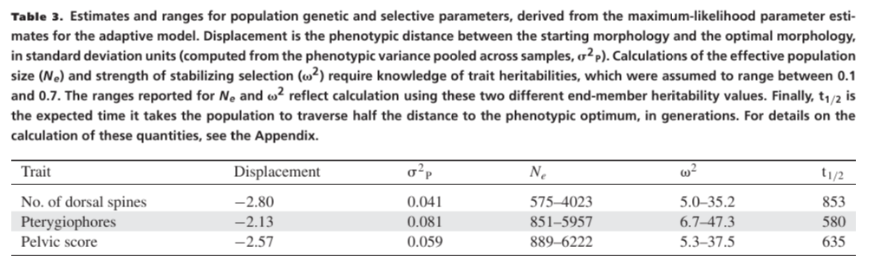
Hunt, Bell & Travis 2007

Slide 17
Strength of OU models: It looks like evolution! Parameters (could potentially) have biological meaning! Weaknesses: Statistical “bad dog”. Without constraints, can behave wildly.

Slide 18
But what if the optimum doesn't have discrete shifts? What if it moves continuously?

Slide 19
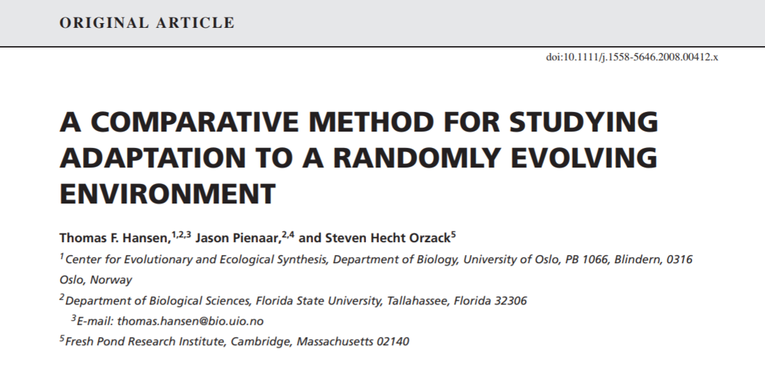
SLOUCH (Hansen, Pienaar & Orzack 2008)

Slide 20
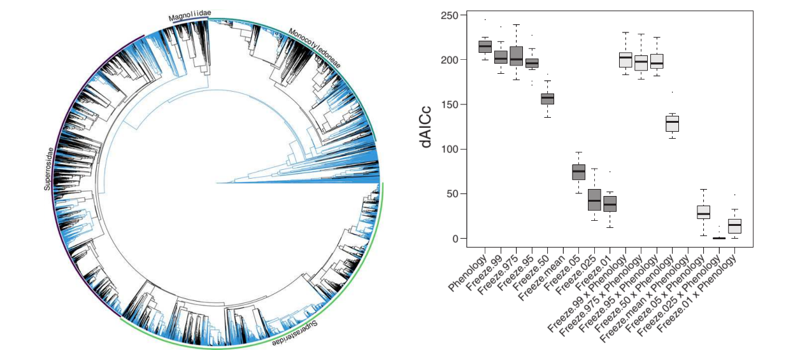
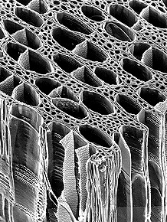
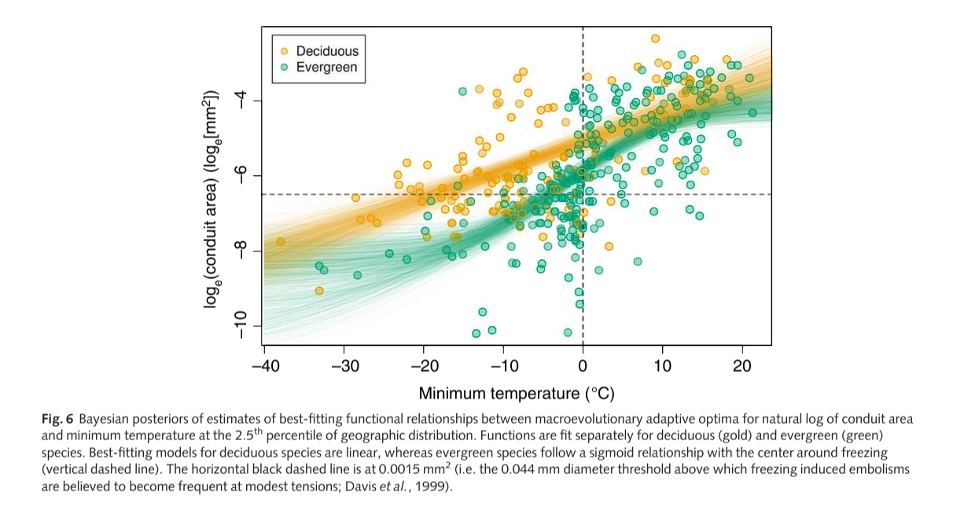

Slide 21
Method | Shift mapping | α & σ | Multivariate? | Optimum change | Inference approach | Predictors? | Convergent regimes?
OUCH (Butler & King 2004) | User hypotheses | Global | Yes | Discrete | Maximum Likelihood | Discrete regimes | Yes
Ouwie (Bealieu et al. 2012) | User hypotheses/ simmap | Regime-specific | No | Discrete | Maximum Likelihood | Discrete regimes | Yes
mvMORPH (Clavel 2015) | User hypotheses/ simmap | Global | Yes | Discrete | Maximum Likelihood | Discrete regimes | Yes
SLOUCH (Hansen et al. 2008) | None | Global | No | Brownian Motion | Maximum Likelihood | Continuously-evolving predictors | N/A
mvSLOUCH (Bartoszek et al. 2012) | None | Global | Yes | Brownian Motion/OU | Maximum Likelihood | Continuously co-evolving | N/A
SURFACE (Ingram & Mahler 2013) | Data driven (Stepwise AIC) | Global | Pseudo | Discrete | Maximum Likelihood | No | Yes
l1ou (Khabbazian et al. 2016) | Data driven (Lasso) | Global | No | Discrete | Maximum Likelihood | No | Yes
PhylogeneticEM (Bastide et al. 2018) | Data driven (Expectation maximization) | Global | Yes | Discrete | Maximum Likelihood | No | Yes
Bayou (Uyeda & Harmon 2014) | Data driven (RJMCMC) | Global | No | Discrete + | Bayesian | Regression framework | Not with RJMCMC

Slide 22
Overwhelmed? Take-home:
Lots of variations on a basic model (OU)
Models where everything vary -> Probably too complicated to fit to real data!
How you can simplify the model with what you KNOW.
Choose software that tests YOUR hypothesis and lets you incorporate YOUR knowledge

Slide 23
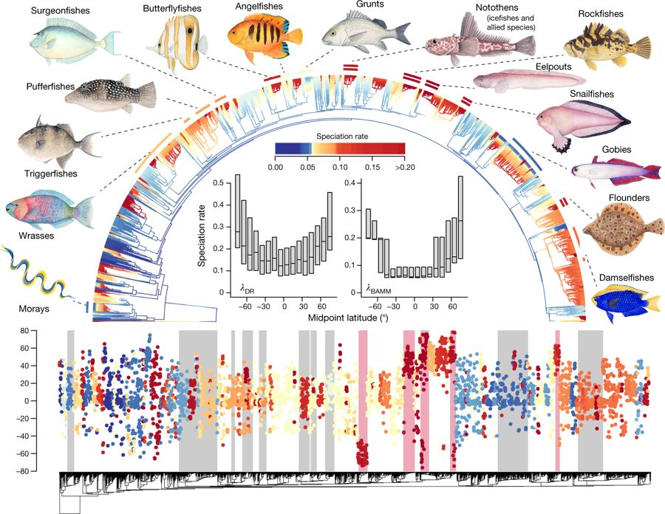
Similar models for Diversification: BAMM (Rabosky 2014)
Rabosky et al. 2018, Nature

Slide 24
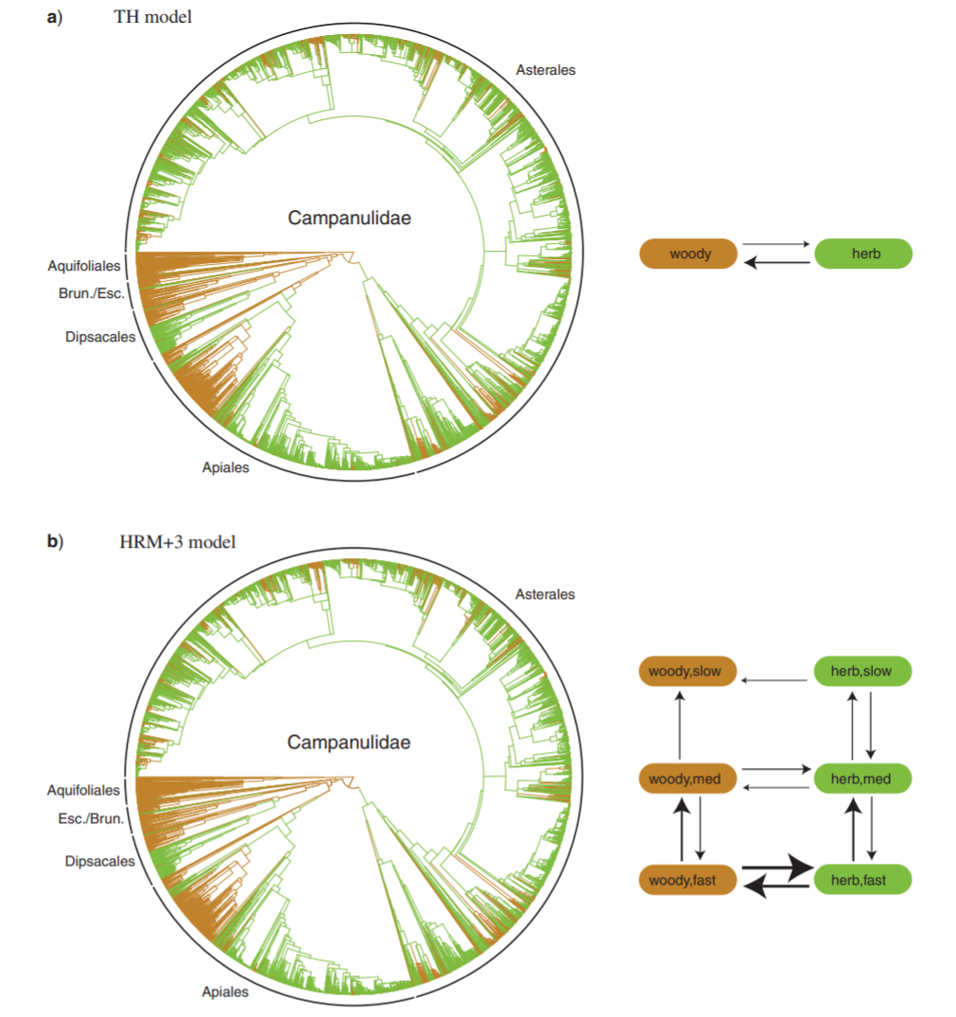
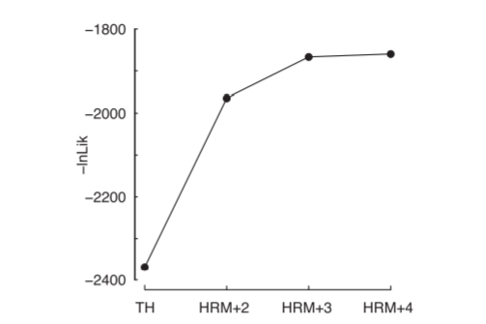
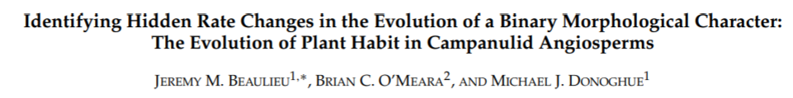
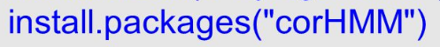
Shifts in Discrete Character Data: Hidden State Models

Slide 25
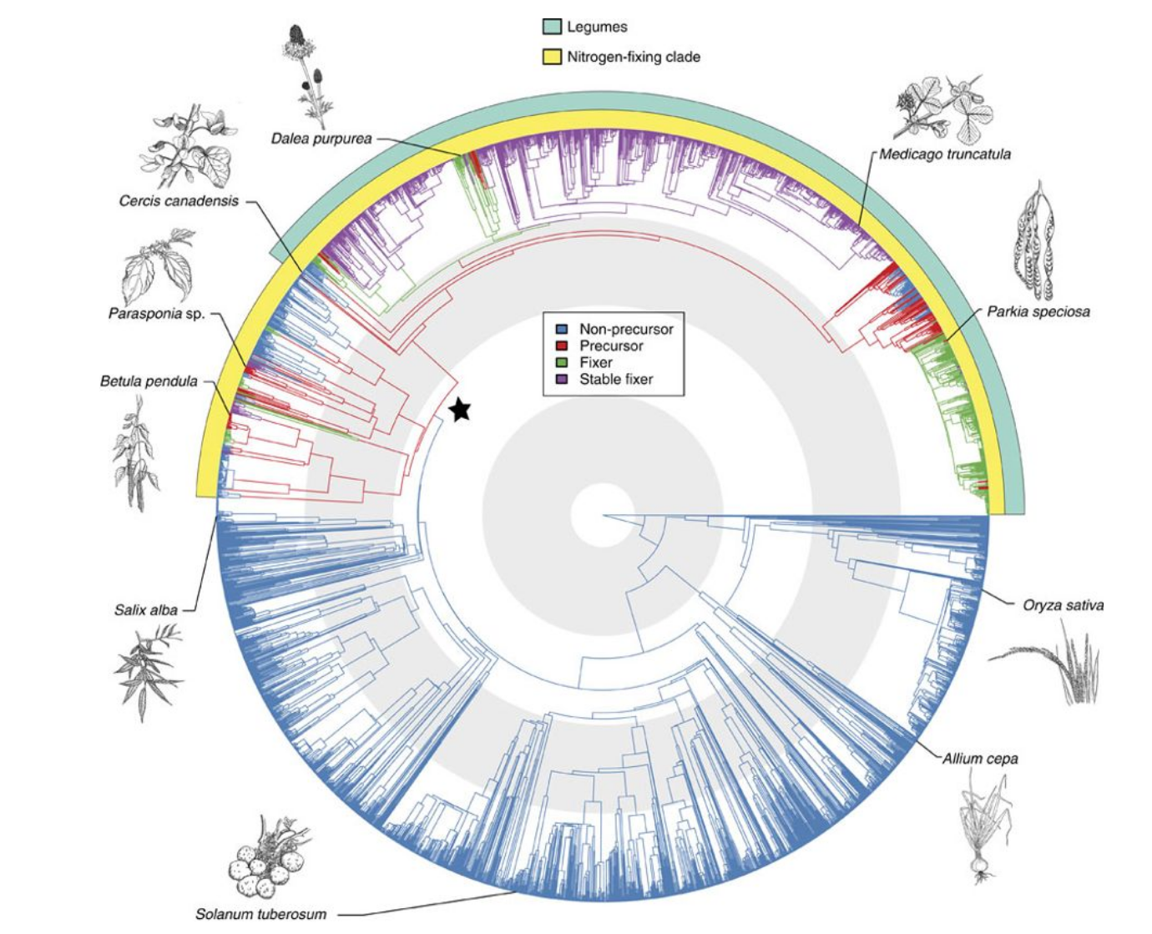
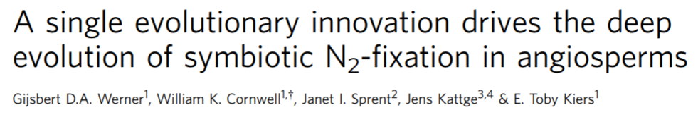

Slide 26
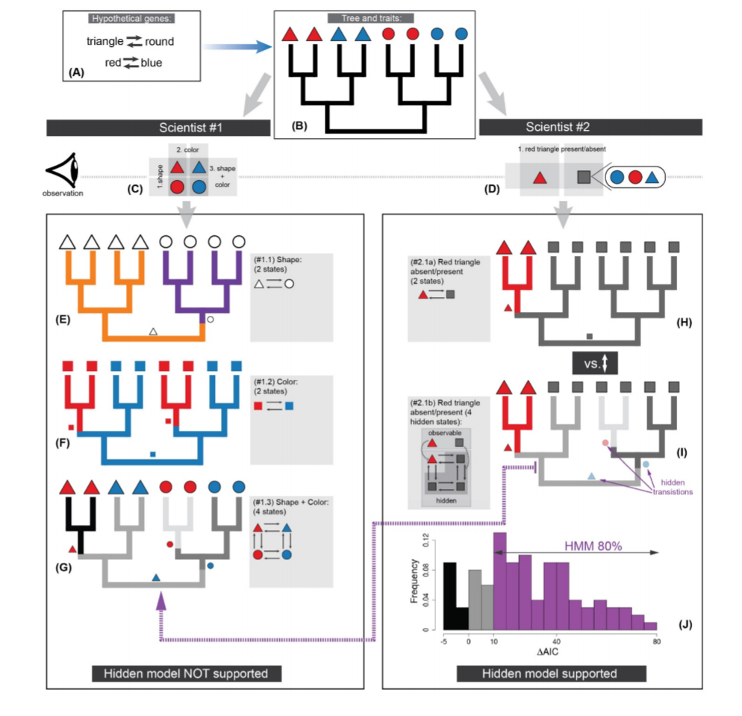
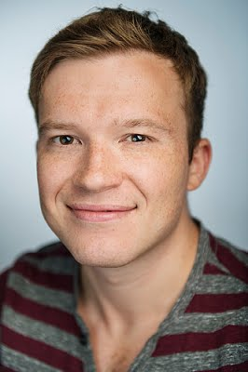
Two-scientist Paradox Sergei Tarasov

Slide 27
Like phylogenetic models, lots of PCMs devoted to heterogeneity in the tempo & mode of evolution
Continuous traits:
BM (bayestraits, Auteur, BAMM, OUwie)
OU (bayou, l1ou, PhylogeneticEM)
Discrete traits
Hidden State Models (corHMM)
Diversification Models (BAMM, HiSSE, FiSSE)

Slide 28
The PCM “Sweet Spot”
Sample Size (N)
N too small fit models
Assumptions break down, too much heterogeneity in evolutionary process

